Slide 1
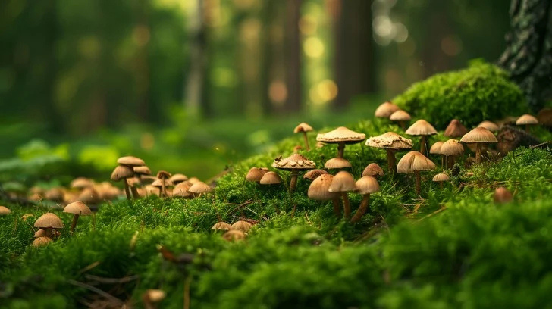
Mushroom Classification Project Presentation
Presented by- Shashikala Londhe

Slide 2
Contents:
Introduction to the topic
Problem Statement
Objective
Technology Used
Architecture Design
Data Information
Data Visualization
Web Designing
Percentage

Slide 3
Introduction :
The Audubon Society Field Guide to North American Mushrooms contains descriptions of hypothetical samples corresponding to 23 species of gilled mushrooms in the Agaricus and Lepiota Family Mushroom (1981). Each species is labelled as either definitely edible, definitely poisonous, or maybe edible but not recommended. This last category was merged with the toxic category. The Guide asserts unequivocally that there is no simple rule for judging a mushroom's edibility, such as "leaflets three, leave it be" for Poisonous Oak and Ivy. The main goal is to predict which mushroom is poisonous & which is edible.
1

Slide 4
Problem Statement:
The identification of edible and poisonous mushrooms is a complex and risky task that often requires expert knowledge in mycology. Misidentifying a poisonous mushroom as edible can lead to severe health consequences, even death.
❓ Key Challenge
There are no numeric features in the dataset — all features are categorical, making it a unique challenge for machine learning models.
The visual similarities between edible and poisonous mushrooms make manual identification unreliable.
1

Slide 5
Objectives:
Development of a system to find out whether a given mushroom
is poisonous or not poisonous. The main goal is to find whether a
mushroom is edible or not after studying its physical noticeable
properties.
1

Slide 6


Technology Used:
Technology: Web application, Machine Learning
Domain: Agriculture
Language: Python
1

Slide 7
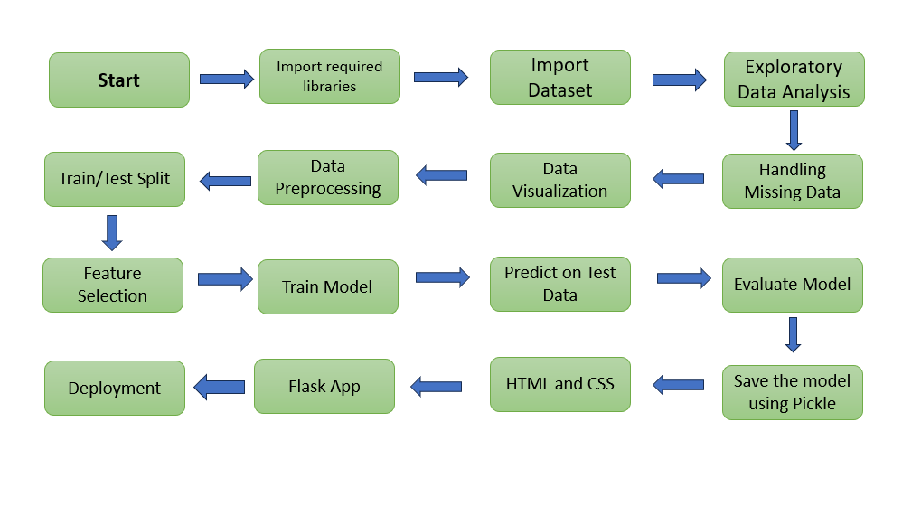
System Architecture:
2

Slide 8
Data Information:
The dataset includes categorical characteristics on 8,124 mushroom samples
from various species of gilled mushrooms.
• The target variable assessed was a class distinction of 'edible' or
'poisonous'.
• The explanatory variables covered a range of descriptive and visual
characteristics on the structure of each observed mushroom - such as, cap
color, odor, ring number and stalk shape.
3

Slide 9
Model Training:
1. TRAINING AND TESTING DATASET -
As here 80 % of dataset has been trained and 20% of dataset has been tested.
2. FINDING ACCURACY WITH DIFFERENT MODEL -
All the supervised machine learning algorithm were used to classify the output such as Decision tree, Random forest etc. found ccuracy with every models.
3. MODEL BUILDING -
After checking accuracy with different model, model building was created with the best accuracy and saved the model in pickle format.
3

Slide 10
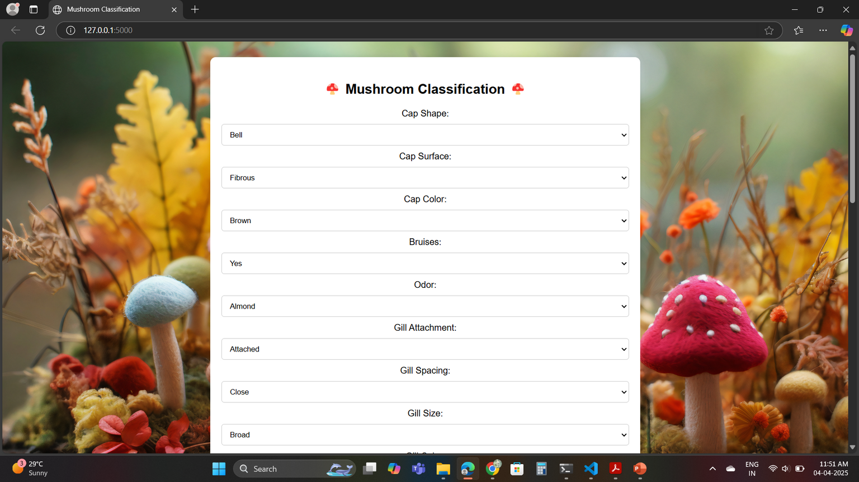
Web Designing:
3

Slide 11
Thanks You....!
3

